Slide 1
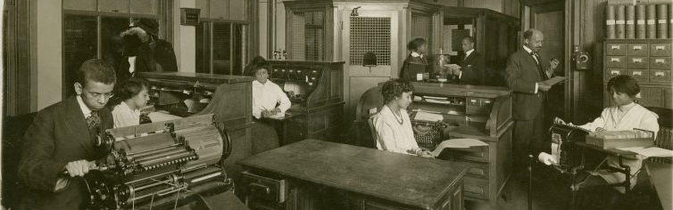
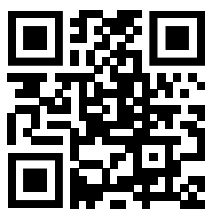
Propaganda and Politics A Du Boisian Theory of Social Movements
Neal Caren University of North Carolina, Chapel Hill

Slide 2
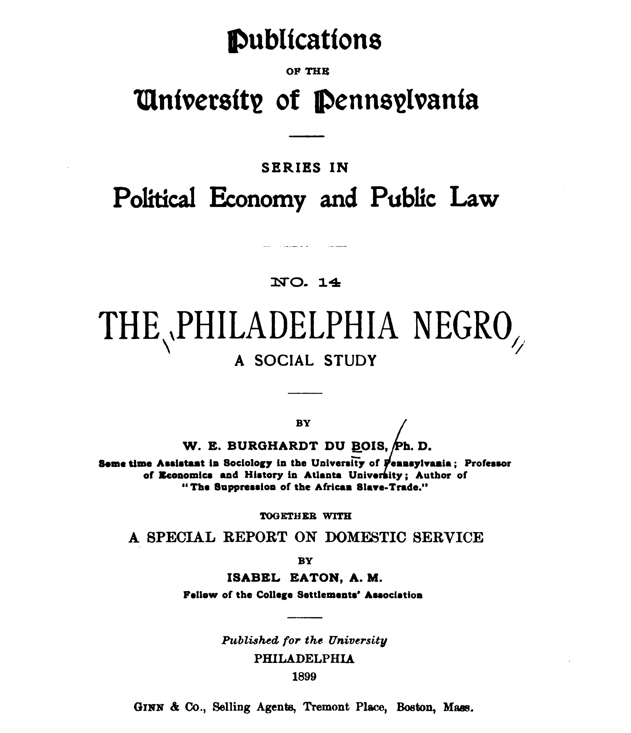
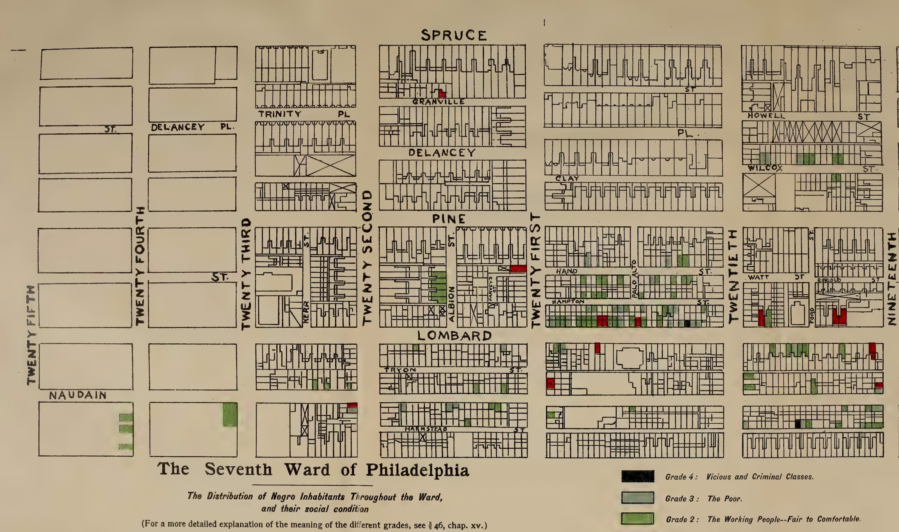
Du Bois as Sociologist

Slide 3
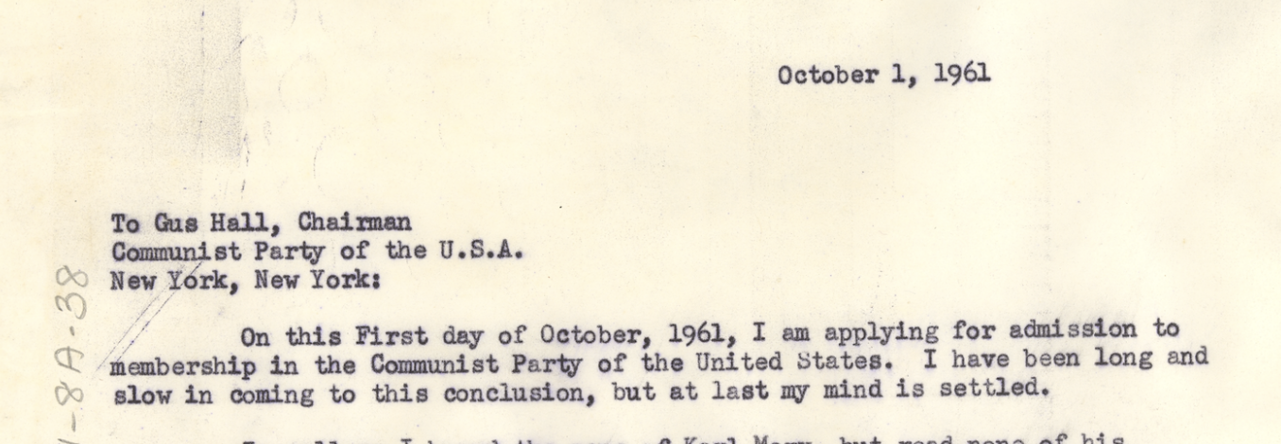
Du Bois as Communist

Slide 4
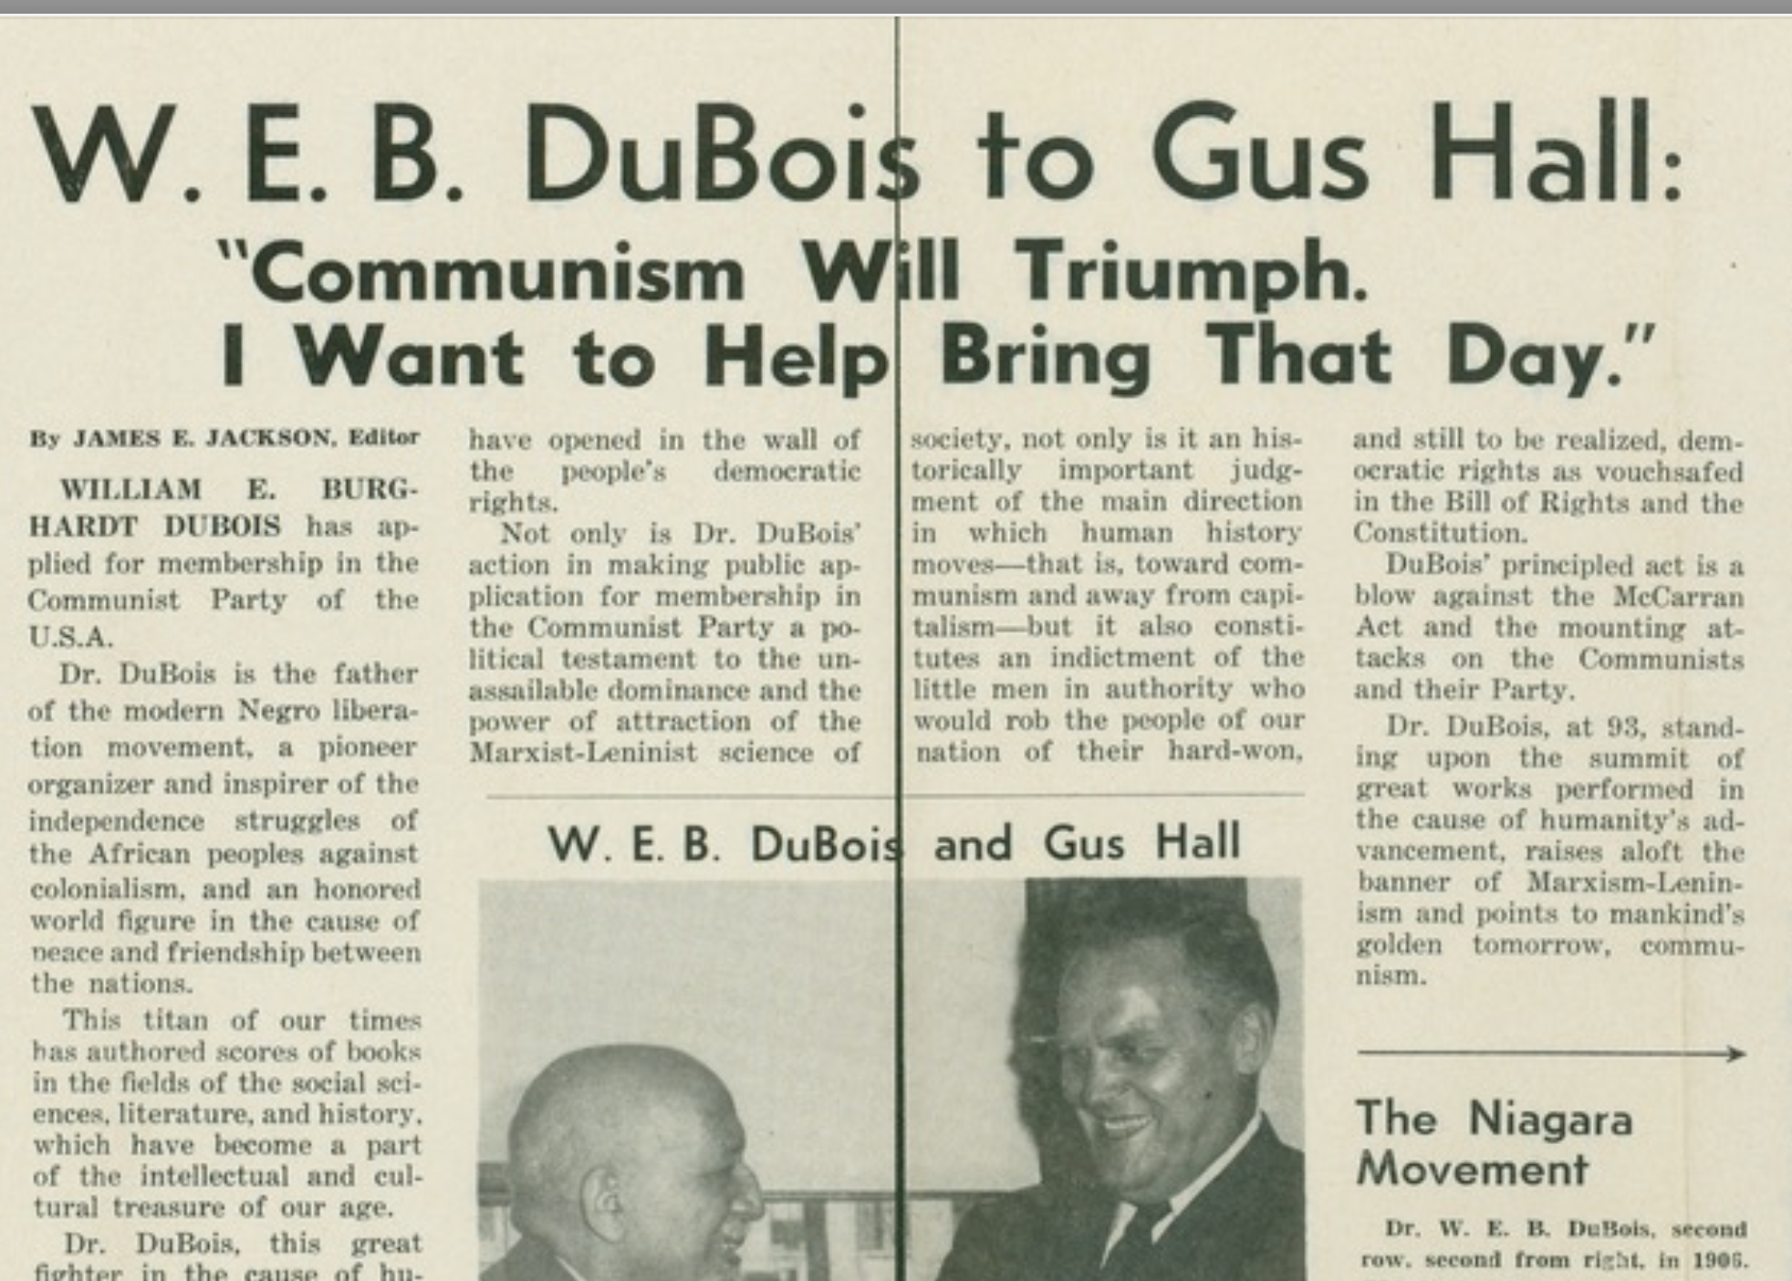

Slide 5
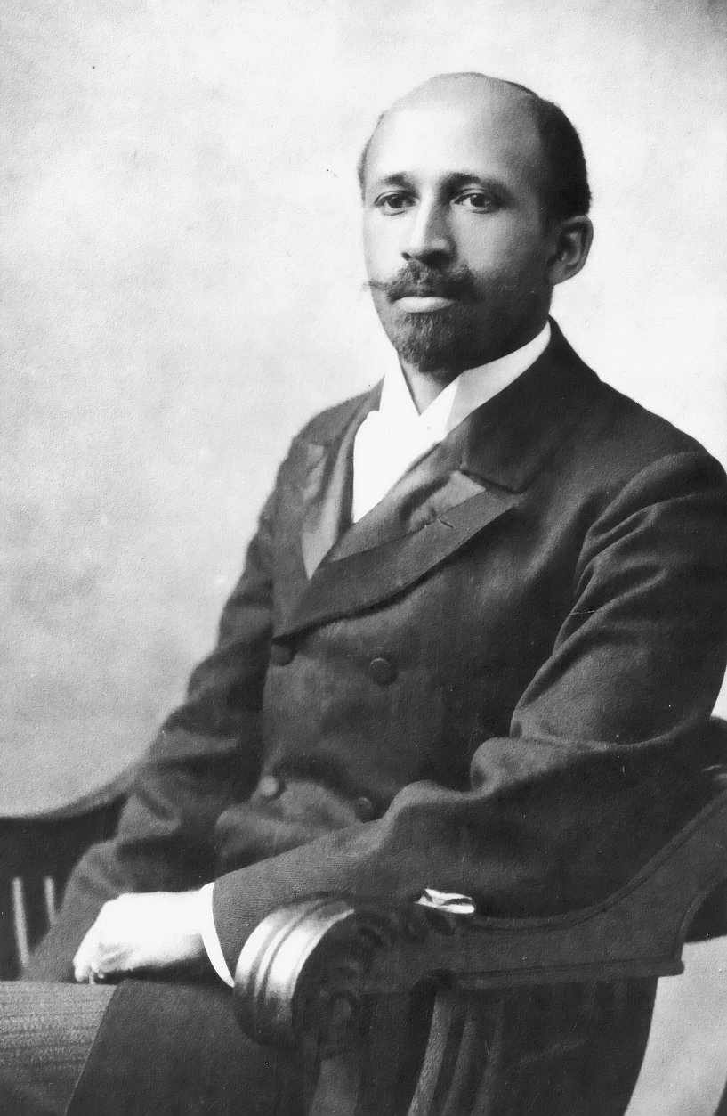
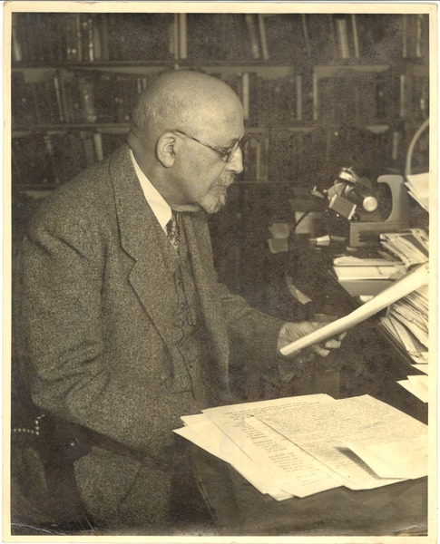
Notes:
And I know there’s aeveral other Du Bois in there as well, including 1935 Reconstruction.

Slide 6
Du Bois as Editor

Slide 7
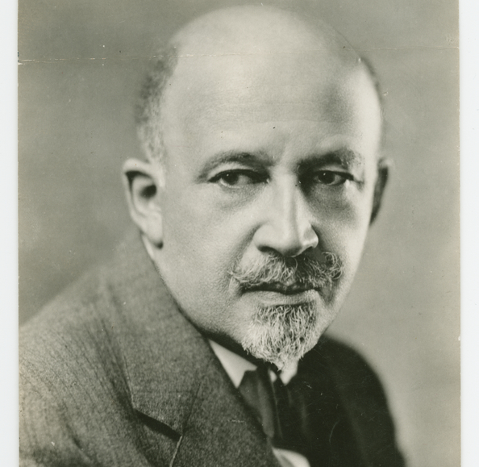
The Crisis 1910-1934
Ages 42-65
Notes:
286 issues he edited, contributed thousands of pieces

Slide 8
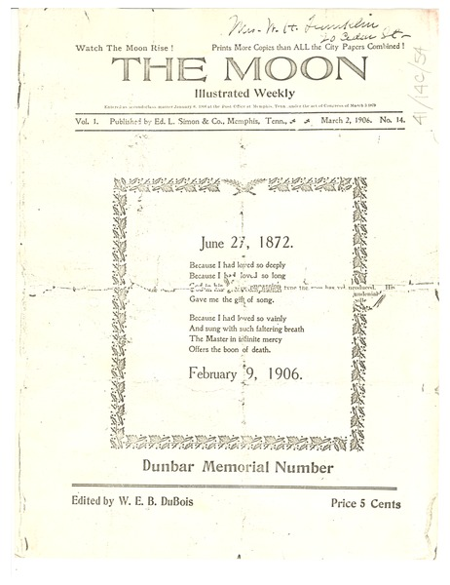
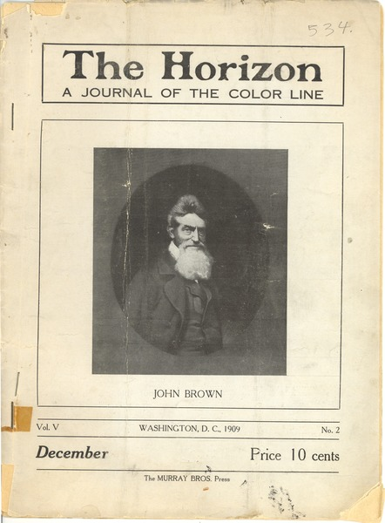
Notes:
William Monroe Trotter's departure after the 1907 meeting had a serious negative impact on the organization, as did disagreements about which party to support in the 1908 election. Du Bois, with some reluctance, endorsed Democratic Party candidate William Jennings Bryan, but many African-Americans could not bring themselves to break from the Republicans, and William Howard Taft won the election, receiving significant African-American support.[70] The 1908 annual meeting, held in Oberlin, Ohio, was a much smaller affair, and exposed disunity and apathy within the group at both local and national levels.[71] Du Bois invited Mary White Ovington, a settlement worker and socialist he had met in 1904, to address the organization. She was the only white woman to be so honored.[72] By 1908, Washington and his supporters successfully made serious inroads with the press (both white and black), and the Oberlin meeting received almost no coverage.[73] Believing the Movement to be "practically dead", Washington also prepared an obituary of the organization for the New York Age to publish.[61]

Slide 9
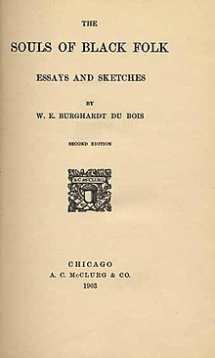
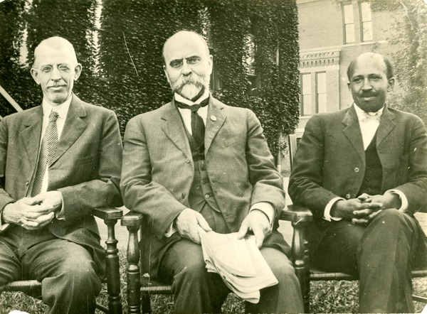
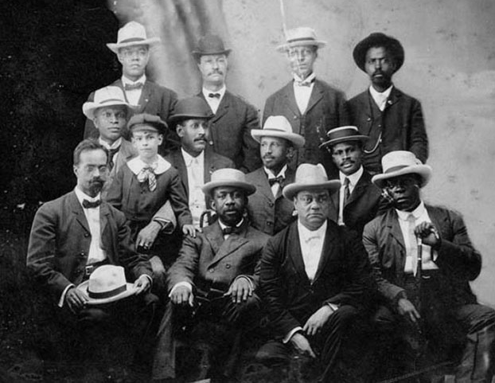
Atlanta University
Niagara Movement

Slide 10
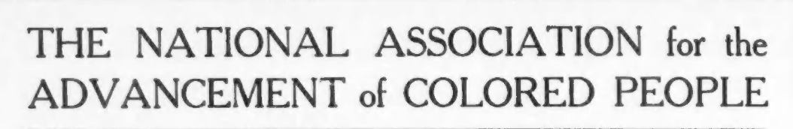
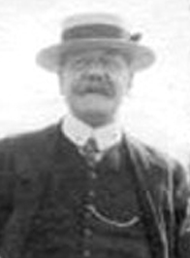
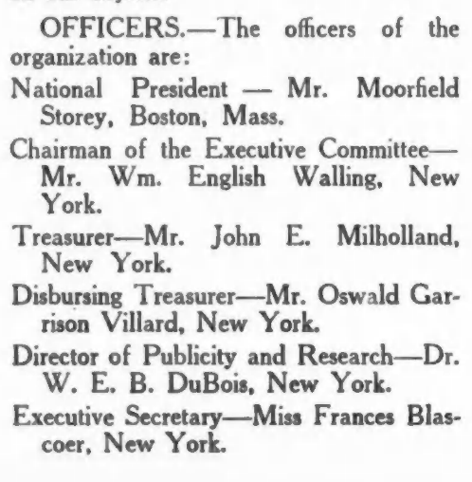
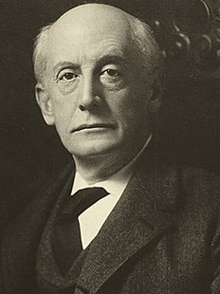
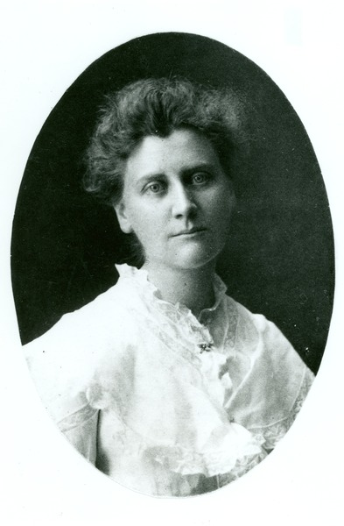
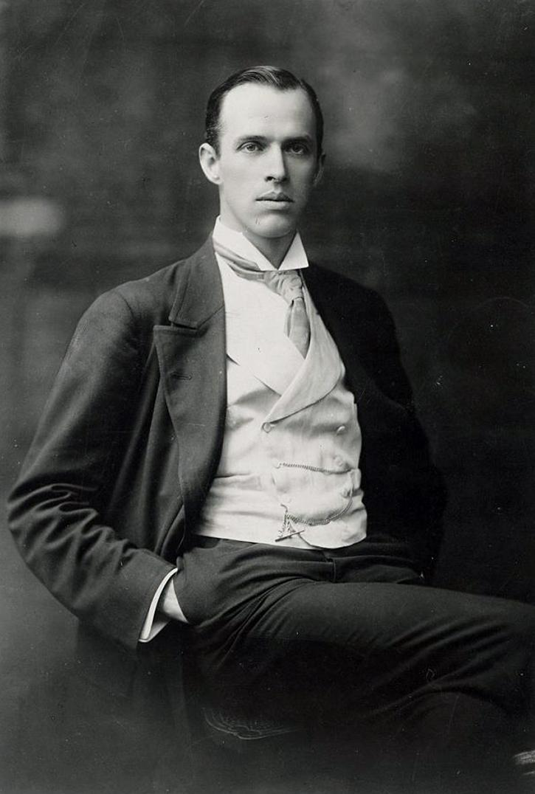
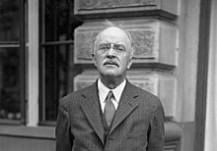
Notes:
President: Moorfield Storey
Chairmen: William English Walling
Treasuer: John Millholand

Slide 11
Notes:
Du Bois had strong but contested authority of the magazine
He didn’t get to print everything he wanted, but he never printed anything he didn’t want to.
This means, we can use the journal as a fairly representative view of how he thought the cause of civil rights could best be advanced.

Slide 12
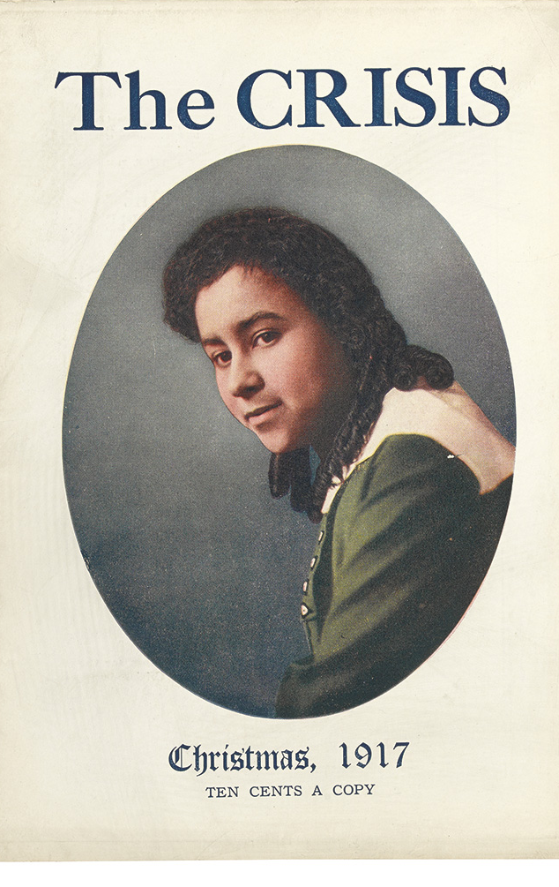
Notes:
Du Bois had strong but contested authority of the magazine
He didn’t get to print everything he wanted, but he never printed anything he didn’t want to.
This means, we can use the journal as a fairly representative view of how he thought the cause of civil rights could best be advanced.

Slide 13
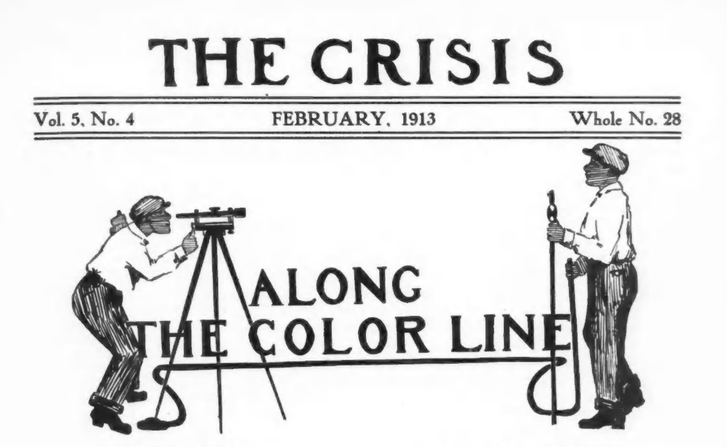
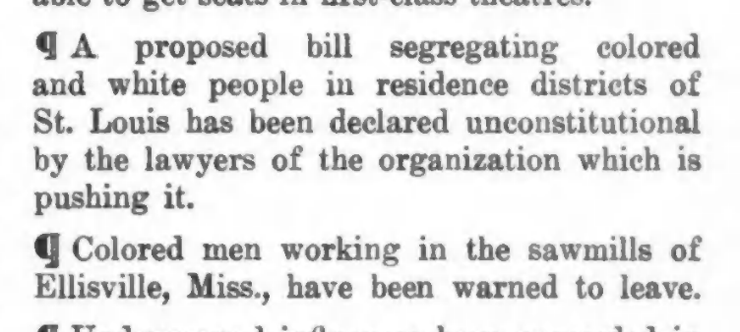
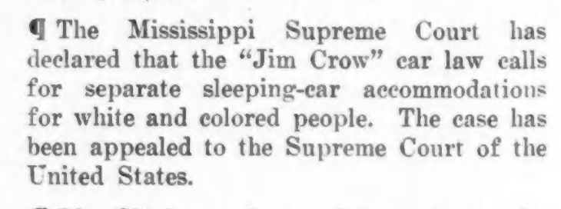

Slide 14
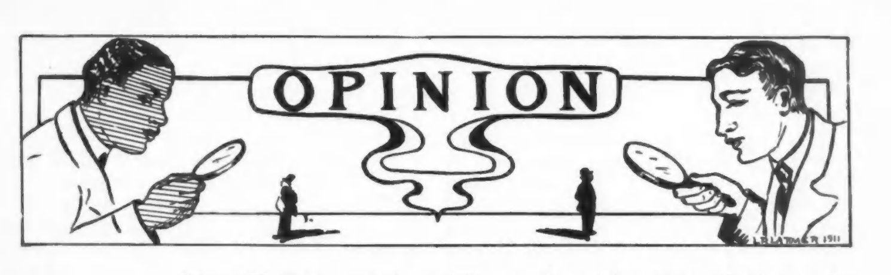
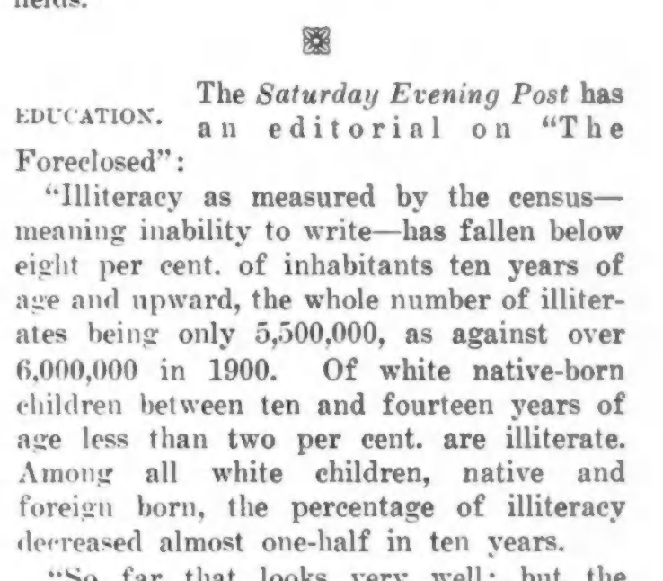
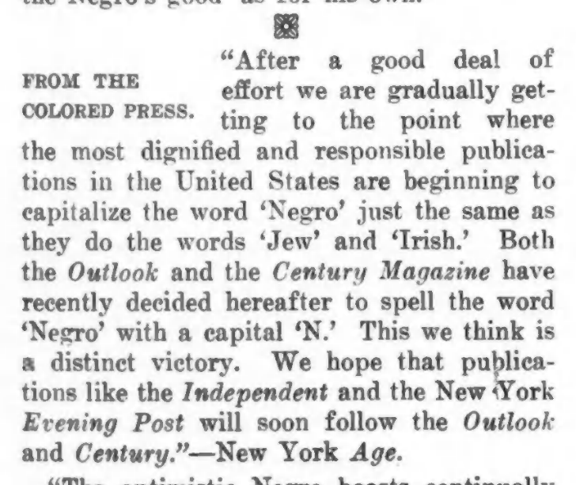

Slide 15
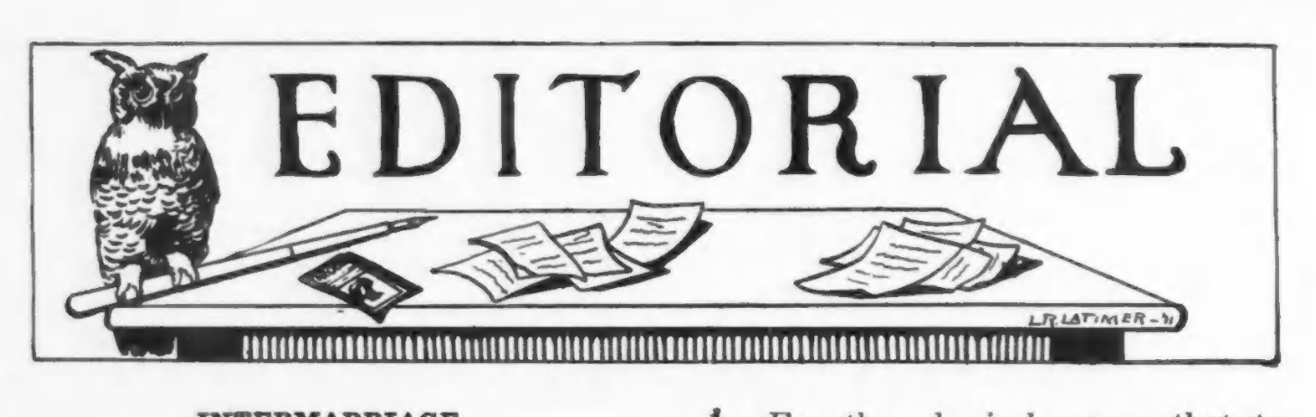
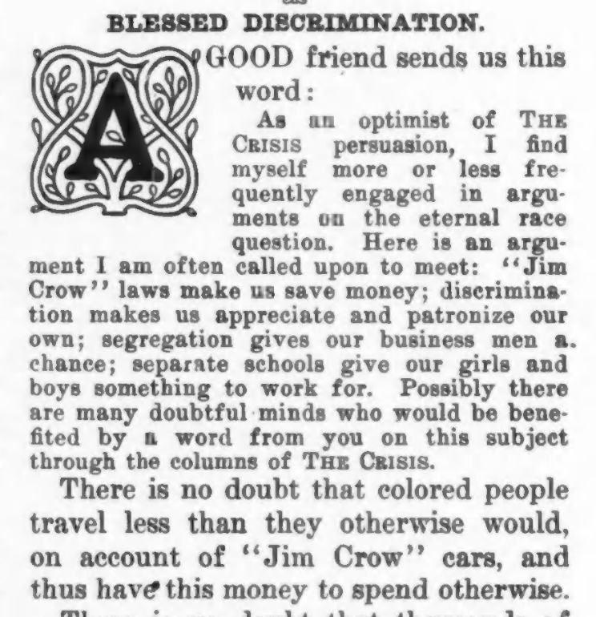
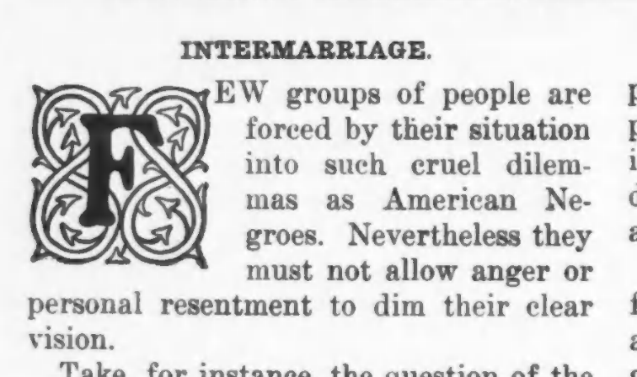

Slide 16
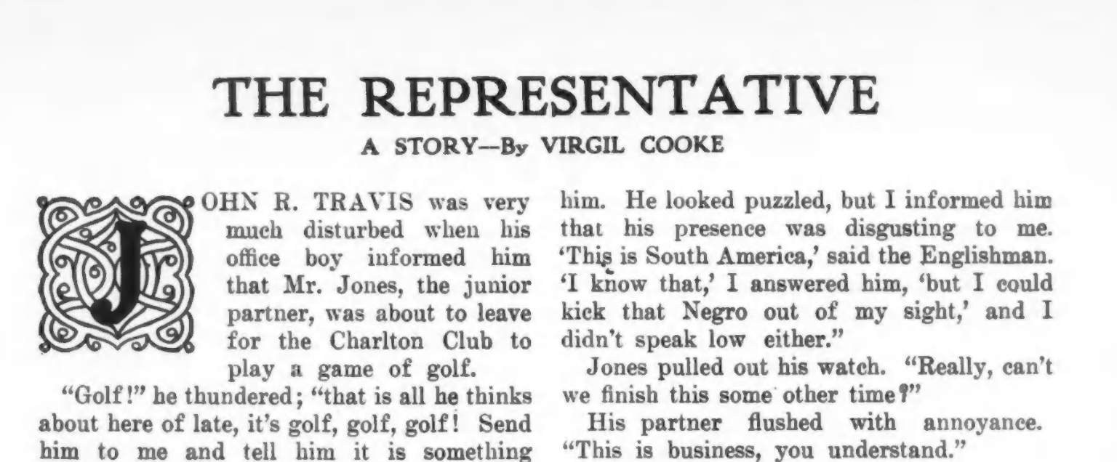

Slide 17
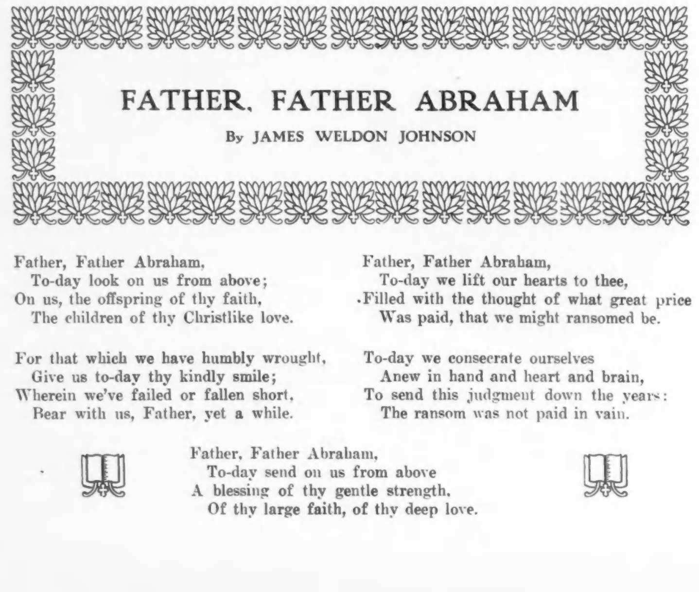

Slide 18
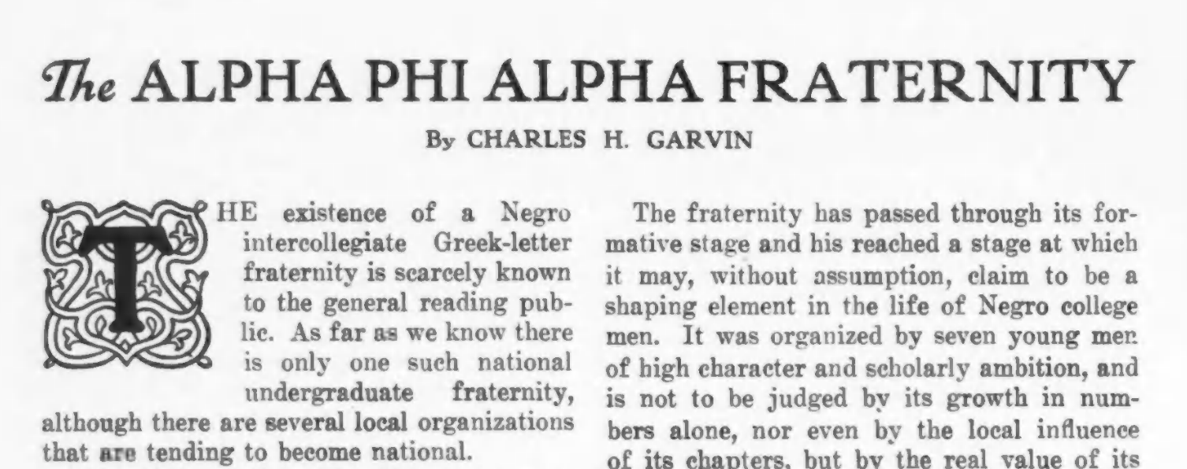
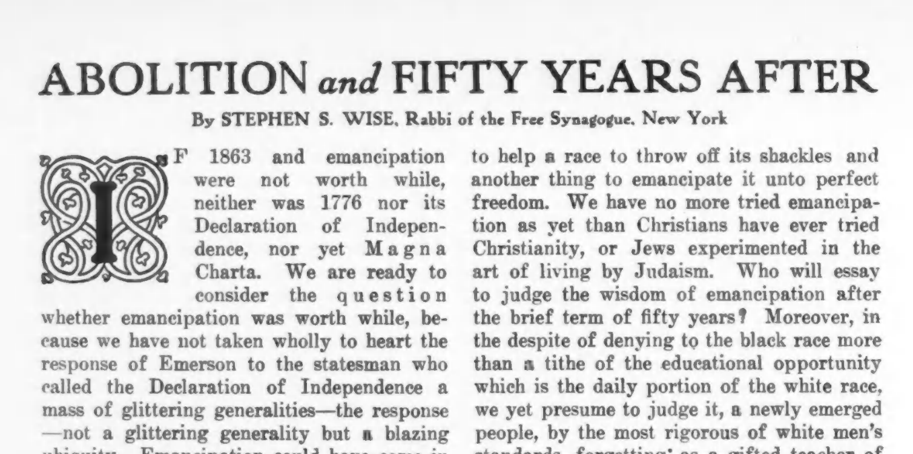

Slide 19
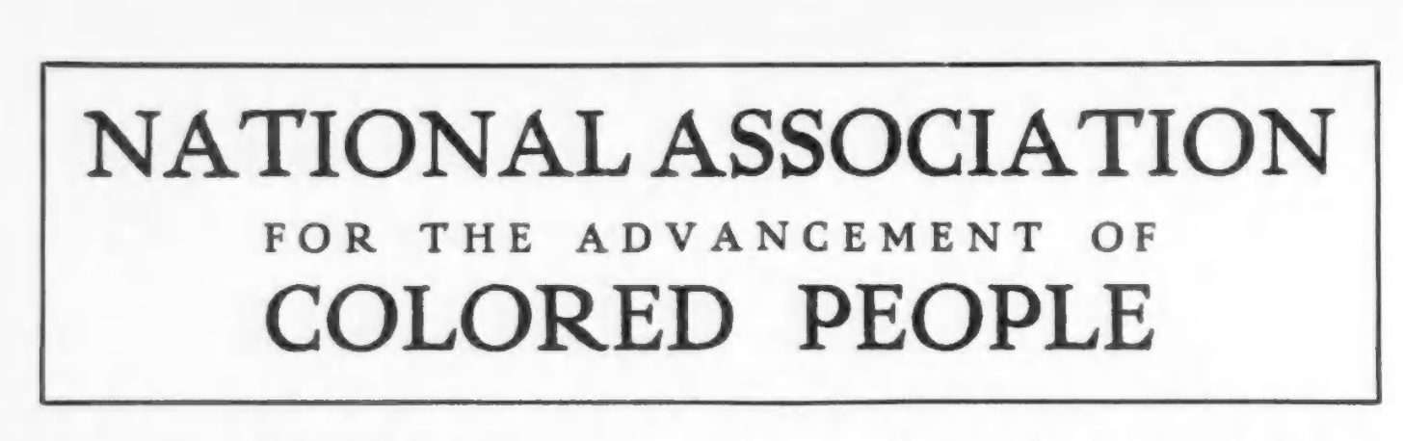
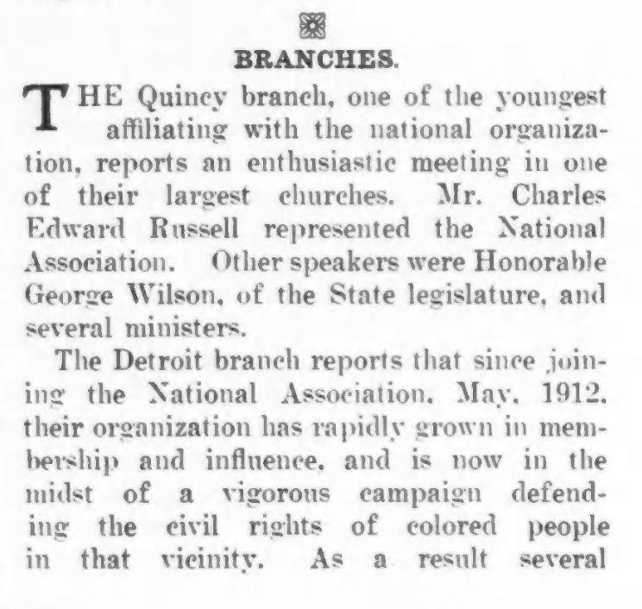
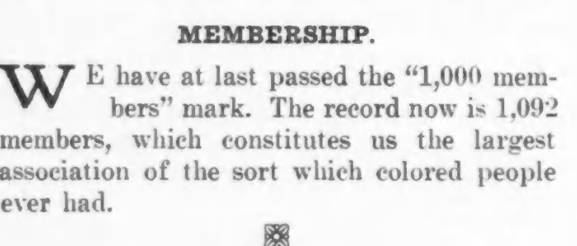

Slide 20
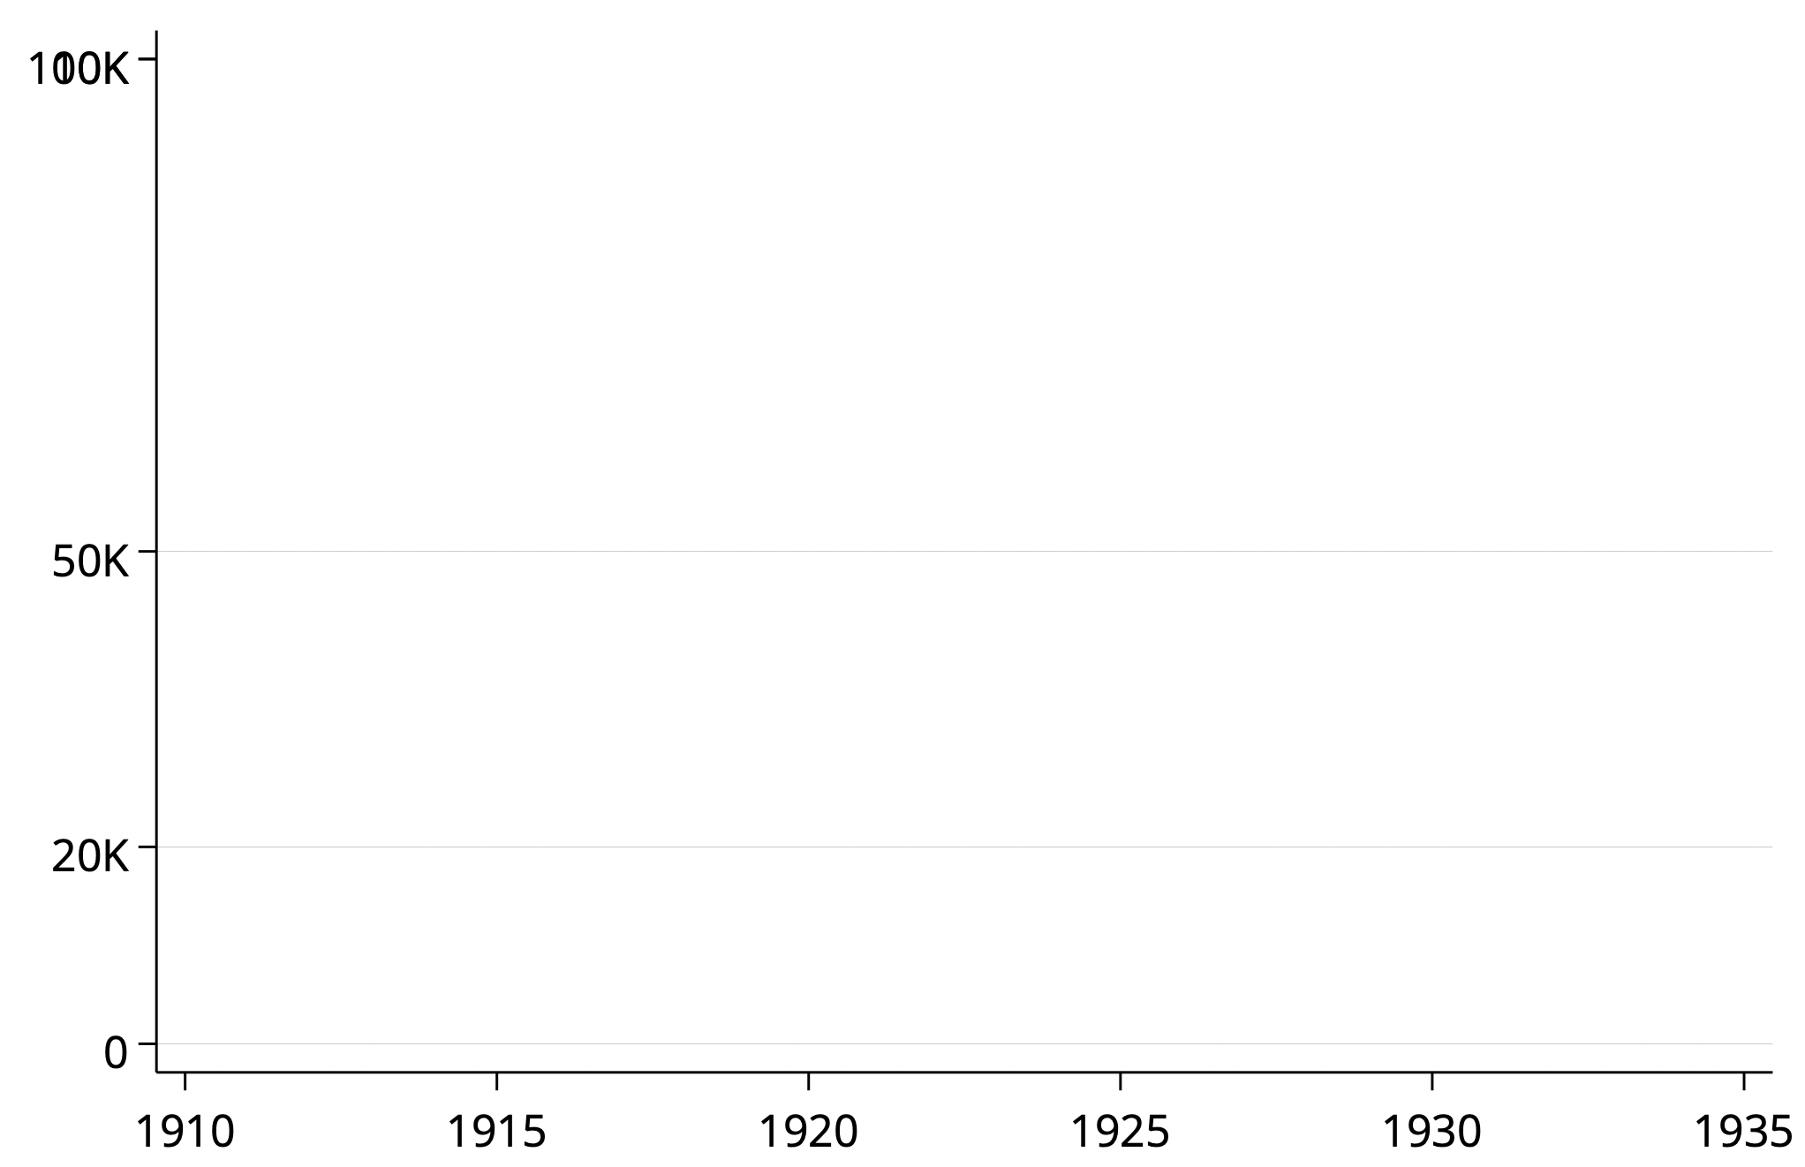

Circulation
Notes:
Largely black base of subscribers gave Du Bois some legitmacy.

Slide 21
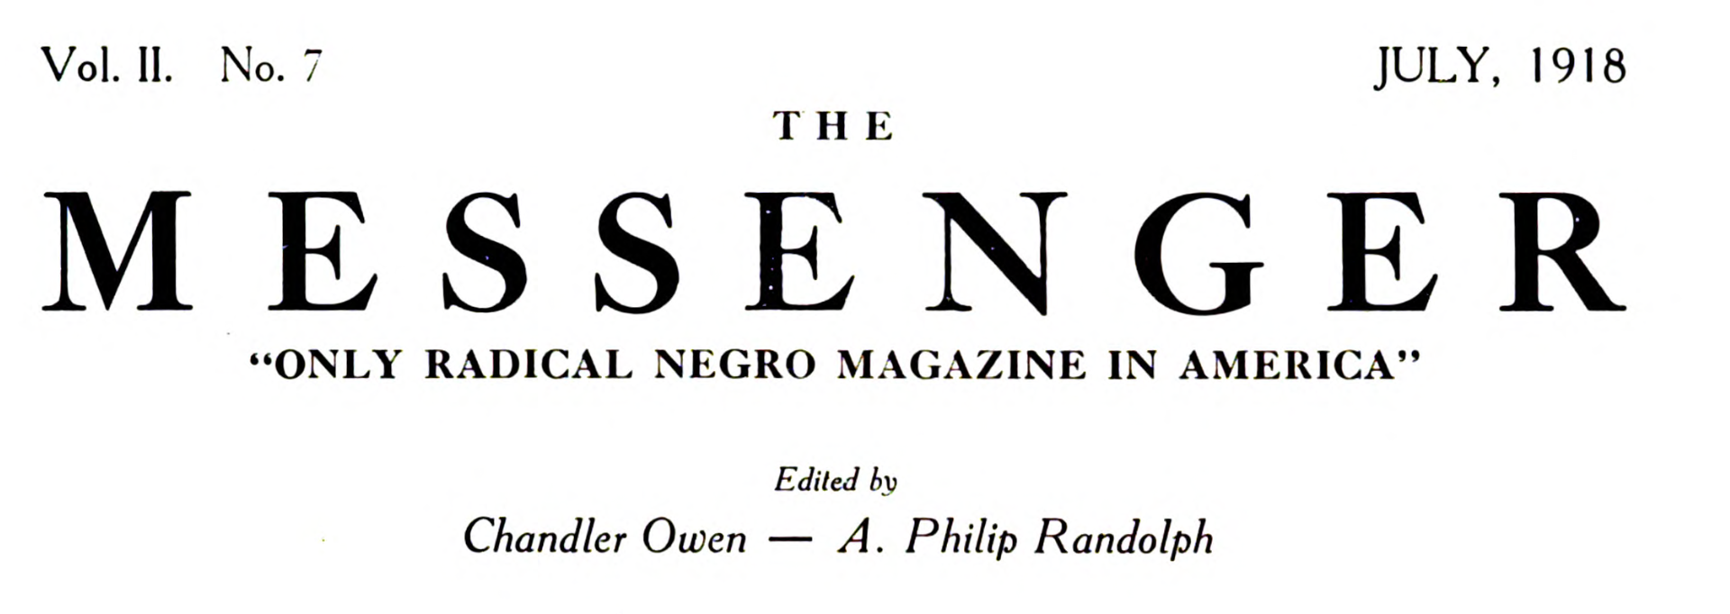
W.E.B. Du Bois is probably the most distinguished Negro in the United States to-day. For the last twenty years he has been known as a radical among Negroes. … Courageous, fearless, cool and honest, we have admired him for many years.

Slide 22
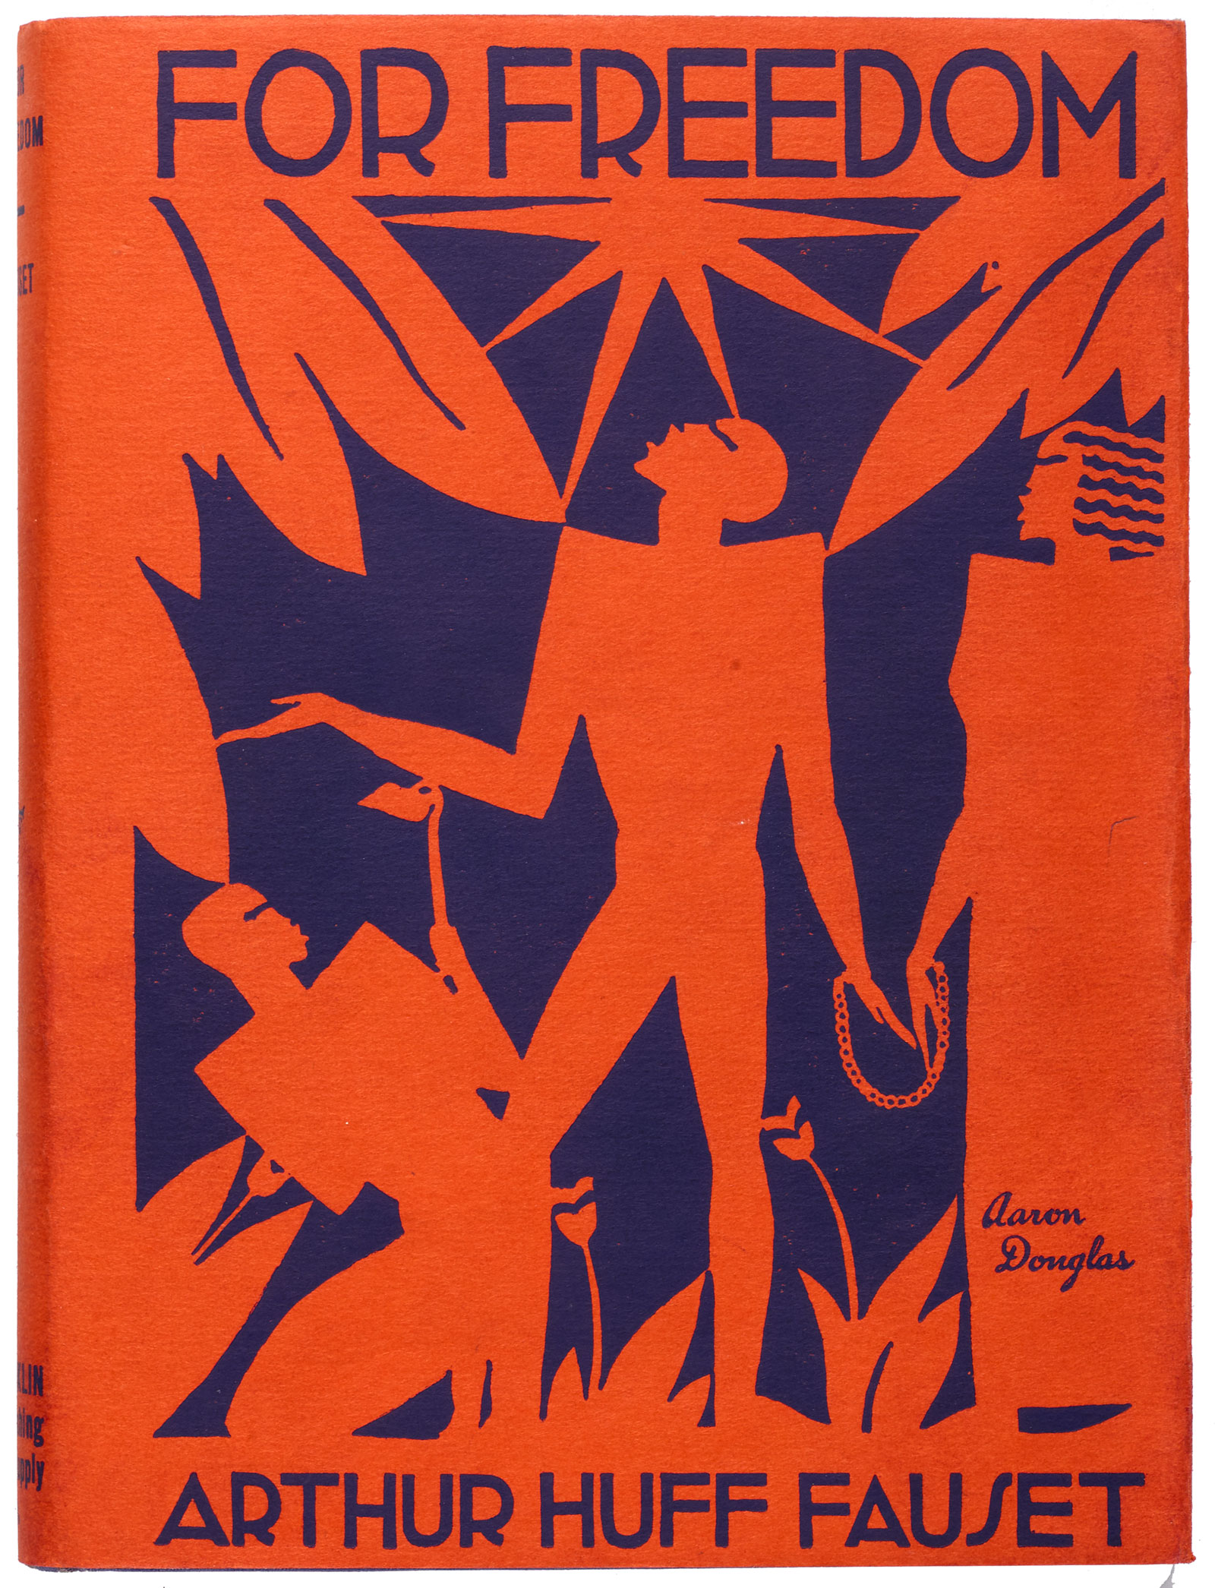
There are many who will say that William E. Burghardt Du Bois is the greatest Negro of them all.
…
Today he stands nearer to being the leader of the group than any living Negro.

Slide 23
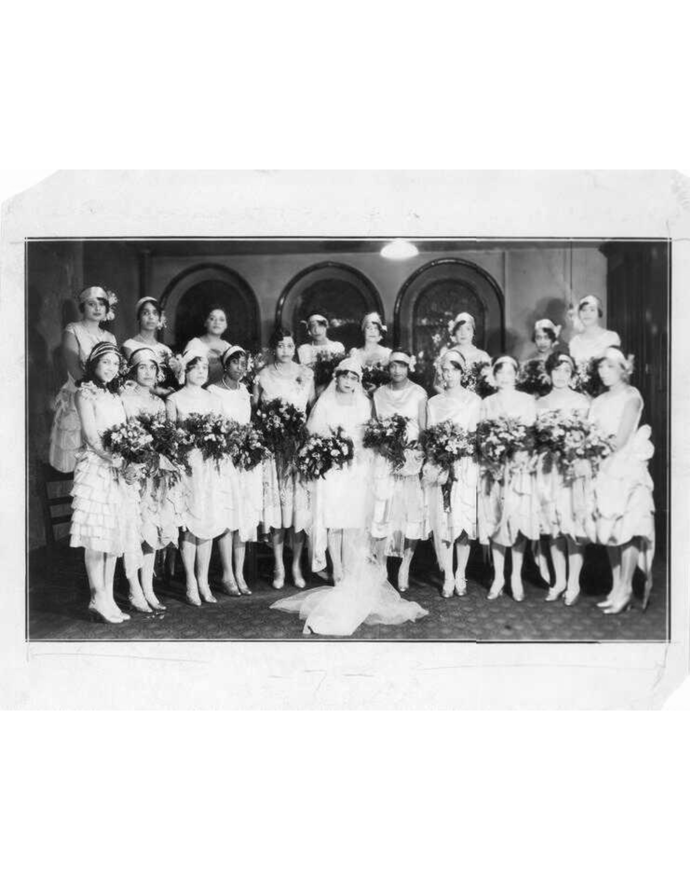
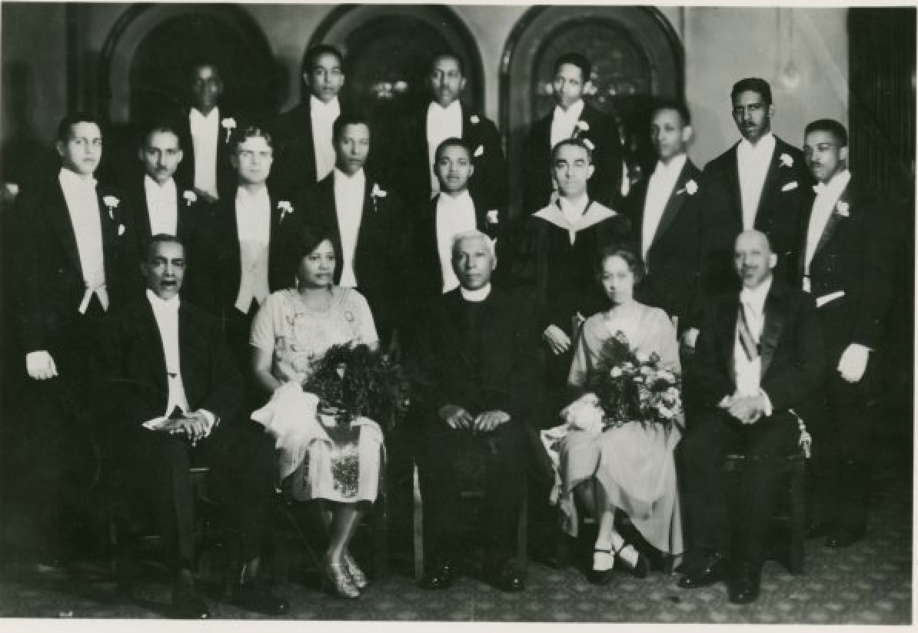
Notes:
Reverend Frederick A. Cullen was pastor of Salem Methodist Episcopal Church in New York City. The church was overcrowded, as 3,000 people came to witness the ceremon

Slide 24
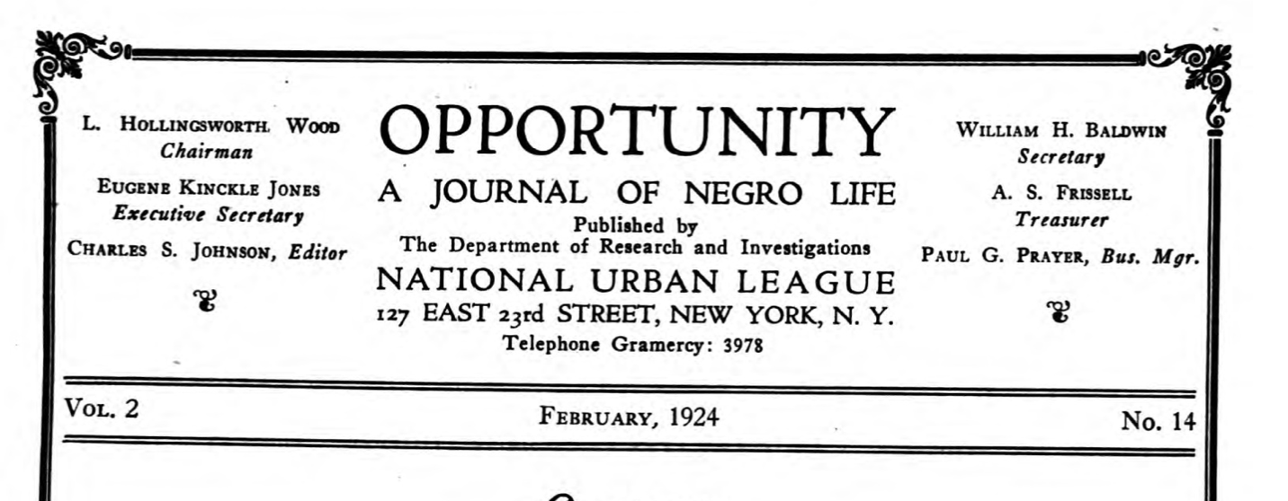
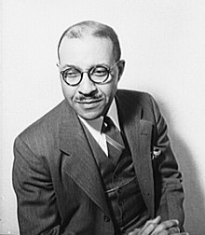

Slide 25
What the talk is actually about

Slide 26
What the talk is actually about
Analyzing Du Bois’s actions as editor shows us how he thought a social movement could win.

Slide 27
Organizations: Stable and unstable

Slide 28
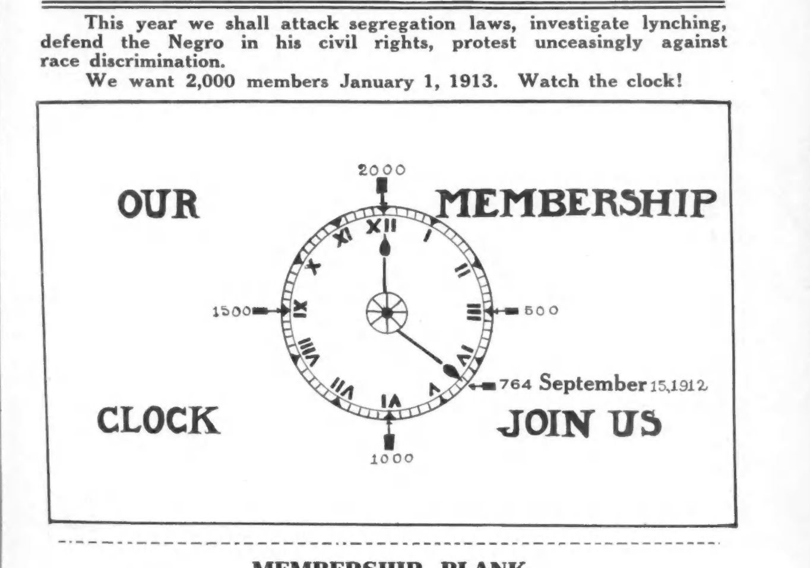

Slide 29
The Vigilance Committee: A Call To Arms (1913)
Many thoughtful colored people have sought to avoid this; to act independently and to refuse to meet organization by organization. This in most cases has been found impossible. The blows of racial and color prejudice fall on all alike, rich and poor, educated and ignorant, and all must stand together and fight.

Slide 30
White Co-Workers (1920)
Organization is sacrifice. You cannot have absolutely your own way—you cannot be a free lance; you cannot be strongly and fiercely individual if you belong to an organization…
But the world’s greatest work must be done by team work.

Slide 31
William Monroe Trotter (1934)
More than that, inner organization is demanded. The free lance like Trotter is not strong enough. The mailed fist has got to be clenched. The united effort of twelve millions has got to be made to mean more than the individual effort of those who think aright.

Slide 32
Join or Die (1914)
There are individual sharpshooters fighting their own effective guerrilla warfare. We greet them and give them all credit.
But the flat fact remains:

Slide 33
Join or Die (1914)
There is in the United States but one organization with permanent headquarters, paid officials, active nation­wide membership, live local branches, a national organ, law officers and traveling organizers, all organized and prepared to make a front forward fight on racial prejudice in this land. Here is the organization.

Slide 34
Notes:
Amenia Conference 1916

Slide 35
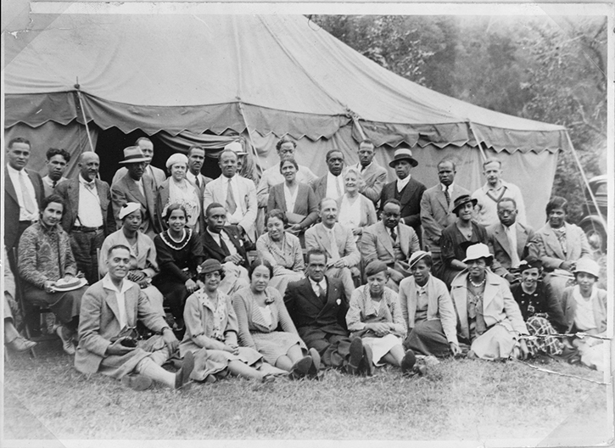
Notes:
Participants in the Amenia Conference, 1933. Third Row (left to right): Ralph Bunche, Edward P. Lovett, W.E.B. Du Bois, Abram Harris, Charles Houston, Grace Nail Johnson, Roy Wilkins, E. Franklin Frazier, Sterling Brown, Lillian Alexander, Emmett Dorsey, William Pickens, Mary White Ovington, Ira De A. Reid, James Weldon Johnson, and Walter White. Second Row (left to right): Hope Spingarn, Hazel Brown, Juanita Jackson, M. Moran Weston, Wenonah Logan, Joel Spingarn, Elmer A. Carter, Mabel J. Bryde, Frank Wilson, and Marion Cuthbert. Front Row (left to right): Dr. Ernest Alexander, Ruth McGee, Dr. Virginia Alexander, Howard Shaw, Anna Arnold, Sara E. Reid, Pauline Young, Frances Williams, unidentified. Photograph. NAACP Collection, Prints and Photographs Division, Library of Congress (078.00.00) Courtesy of the NAACP

Slide 36
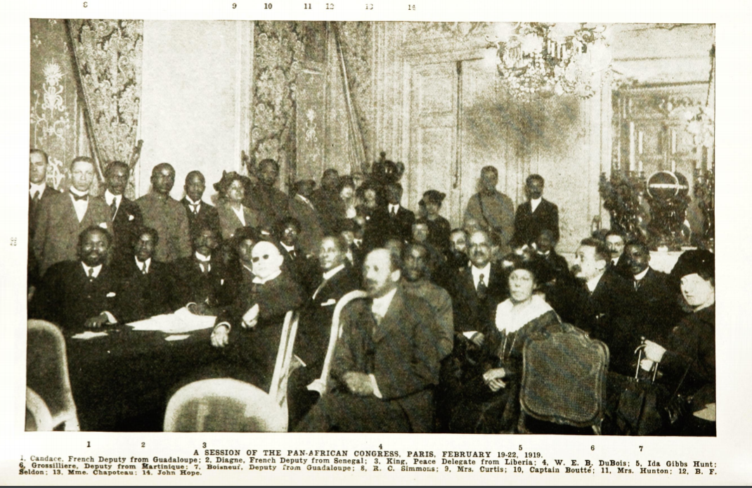
Notes:
1919 Pan African Conference

Slide 37
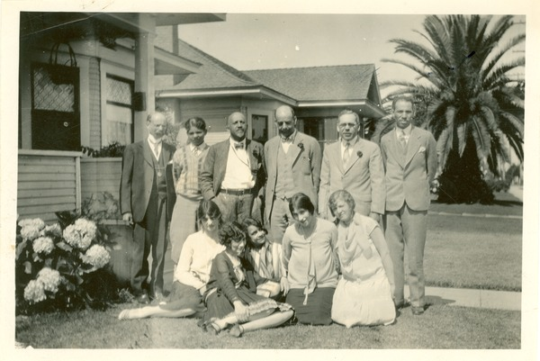
Notes:
Claude McKay- 1922 Report
The petit-bourgeoisie, which whom the race is honeycombed, find expression chiefly in the “National Association for the Advancement of Colored People,” in which a group of bourgeois gentlemen (colored and white) and gentlemen who, while lacking the bourgeois gold, carry around the bourgeois psychology, dominate a large but not compactly organized or effectively functioning body of workers and professionals.

Slide 38
Fact-based propaganda: Statistics and investigations

Slide 39
The Proper Way (1913)
As to lynching, there are four things to do:
Publish the facts,
appeal to the authorities,
agitate publicity and
employ detectives.
Every one of these things we have done.

Slide 40
Publicity (1922)
But let us remember that in pitiless Publicity we have perhaps the greatest militant organ of social reform at our hands.… Until the best black and white people realized the facts concerning the Negro problem, there was no use discussing remedies.
Notes:
So many persons have asked for the complete text of the address delivered by Dr. Du Bois at the Chicago Conference of the National Association for the Advancement of Colored People that we are publishing the address here.

Slide 41
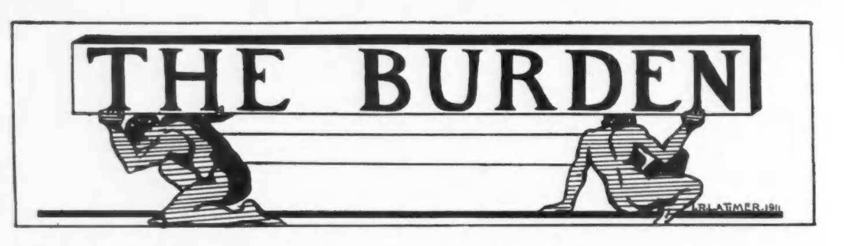




Slide 42



Slide 43

Waco Horror (1916)
Notes:
Citation: Du Bois, W.E.B. 1916. “The Waco Horror.” The Crisis. 12(3-Supplement):1–8.

Slide 44


Notes:
17 Investigations in the Crisis, several of which also received publicity elsewhere, with Walter White’s writings.

Slide 45

Possibility of Democracy (1928)
Notes:
APSR

Slide 46

Our Rate of Increase (1933)
Notes:
Demography

Slide 47
Art-based propaganda: Beauty and Truth, but not too much Truth

Slide 48
The Drama Among Black Folk (1916)
It seemed to me that it might be possible with such a demonstration to get people interested in this development of Negro drama to teach on the one hand the colored people themselves the meaning of their history and their rich, emotional life through a new theatre, and on the other, to reveal the Negro to the white world as a human, feeling thing.

Slide 49


Slide 50

Notes:
Prelude
The lights of the Court of Freedom blaze. A trumpet blast is heard and four heralds, black and of gigantic stature, appear with silver trumpets and standing at the four corners of the temple of beauty cry:
Hear ye, hear ye! Men of all the Americas, and listen to the tale of the eldest and strongest of the races of mankind, whose faces be black. Hear ye, hear ye, of the gifts of black men to this world, the Iron Gift and Gift of Faith, the Pain of Humility and the Sorrow Song of Pain, the Gift of Freedom and of Laughter, and the undying Gift of Hope. Men of the world, keep silence and hear ye this!

Slide 51

Notes:
Prelude
The lights of the Court of Freedom blaze. A trumpet blast is heard and four heralds, black and of gigantic stature, appear with silver trumpets and standing at the four corners of the temple of beauty cry:
Hear ye, hear ye! Men of all the Americas, and listen to the tale of the eldest and strongest of the races of mankind, whose faces be black. Hear ye, hear ye, of the gifts of black men to this world, the Iron Gift and Gift of Faith, the Pain of Humility and the Sorrow Song of Pain, the Gift of Freedom and of Laughter, and the undying Gift of Hope. Men of the world, keep silence and hear ye this!

Slide 52

Notes:
Augustus Granvill Dill in the back. Atlanta student-Harvard MA – Atalnta Studies 11--14., publisher of the. Crisis until 1928…

Slide 53


Slide 54
Harlem Renaissance in The Crisis
Jean Toomer
Zora Neale Hurston
Eric Walrond
Jessie Fauset
Claude McKay
James Weldon Johnson
Angelina Grimke
Langston Hughes
Countée Cullen

Slide 55
Harlem Renaissance in The Crisis
Ottie B. Graham
Ola Calhoun Morehead
Anita Scott Coleman
Marita Bonner
Ethel R. Clark
Marita Bonner
Maude Irwin Owens
Brenda Ray Moryck
Iva L. Cotton
Annice Calland

Slide 56
Criteria of Negro Art (1926)
Thus all Art is propaganda and ever must be, despite the wailing of the purists. I stand in utter shamelessness and say that whatever art I have for writing has been used always for propaganda for gaining the right of black folk to love and enjoy. I do not care a damn for any art that is not used for propaganda.
Notes:
So many persons have asked for the complete text of the address delivered by Dr. Du Bois at the Chicago Conference of the National Association for the Advancement of Colored People that we are publishing the address here.

Slide 57

Two Novels (1928)
Claude McKay’s “Home to Harlem” …
for the most part nauseates me, and after the dirtier parts of its filth I feel distinctly like taking a bath.

Slide 58



Slide 59
Challenging Propaganda: Rejecting the negative

Slide 60
That Capital ‘N’ (1916)
From time to time persons write us for a brief statement of the reasons for capitalizing the word Negro.
The ordinary rules of capitalization enjoin the use of a capital letter for all proper nouns, all names of tribes, races, sects or organized bodies of men.
If, therefore, we follow analogy we cannot refuse to capitalize Negro when we capitalize Caucasian, Malay, Indian, Chinese, etc. Not to capitalize Negro under such circumstances is a direct, and in these days a more and more conscious, insult to at least 150,000,000 human beings

Slide 61
Libelous Film (1921)
Last month “The Birth of a Nation” with its cruel and indefensible libel of the Negro and glorification of the mob in the Ku Klux Klan was revived in several eastern cities. In Boston it was suppressed; in New York the N.A.A.C.P. planned a public protest. We secured former service men and women Y.M.C.A. secretaries who had served abroad, to march before the Capitol Theatre and distribute bills and carry placards.
Notes:
Monroe Trotter – “In Boston it was suprpressed.”

Slide 62



Slide 63
Libelous Film (1921)
They were arrested. The first judge was vociferous and wanted to charge them with inciting riot. The second judge was calmer and offered to let them go if they would promise not to do it again. This they refused to do and were released on suspended sentence. They appealed the case. The names of these public servants are: Mrs. Helen Curtis, Mrs. Laura Jean Rollock, Miss Katherine Johnson, Edward F. Frazier and Llewelyn Rollock.

Slide 64
Pragmatic Politics - Strategic voting - Long time horizon - Reform over revolution - Country over group

Slide 65
Radicals and the Negro (1925)
It is not always easy to say just how these various needs and disabilities can be met, but most of them call for:
Investigation
Publicity and agitation
An appeal to the courts and the legislatures
Notes:
It’s a long hall.

Slide 66
The N.A.A.C.P. and Parties (1924)
What we need in this campaign is non-partisan centers of discussion and information; debate, facts, statements and re-statements of the high function of the voter and the deep eternal significance of Democracy.
Notes:
It’s a long hall.

Slide 67
The Crisis/Du Bois Endorsements
1912 – Wilson (Democrat)
1916 – Hughes (Republican)
1920 – Harding (Republican)
1924 – La Follette (Progressive Party)
1928 – Thomas (Socialist)
1932 – Roosevelt (Democrat)

Slide 68
The Strategy of the Negro Voter (1933)
How is a Negro to vote? Manifestly, his voting program has got to be purely opportunist….
It makes no difference how much the Communist Party may promise the Negro, so long as the white people of the country refuse support, it is idiotic for the colored people to throw their votes away.
Notes:
It’s a long hall.

Slide 69
DePriest (1929)
In other words, the only organized interests in the United States who could be induced to send a colored man to Congress or any man who stands [civil rights], are the same interests which are allied with the rule of wealth and crime.
Notes:
It’s a long hall.

Slide 71
The Negro and Communism (1931)
Negroes know perfectly well that whenever they try to lead revolution in America, the nation will unite as one fist to crush them and them alone. There is no conceivable idea that seems to the present overwhelming majority of Americans higher than keeping Negroes “in their place.”
Notes:
Against revolution!

Slide 72
Radicals (1919)
The Crisis does not believe in violence as a method of social reform—it does not believe in Revolution
Notes:
Du Bois is in the second row, second from the right, marching next to James Weldon Johnson.

Slide 73
Let us Reason Together (1919)
We must never let justifiable self-defense against individuals become blind and lawless offense against all white folk. We must not seek reform by violence.
Notes:
Du Bois is in the second row, second from the right, marching next to James Weldon Johnson.

Slide 74
Hubert Harrison - A Cure for the Ku-Klux
What will the N.A.A.C.P. do besides writing frantic letters? We fear that they can never rise above the level of appeals.
Suppose the common Negro in Tennessee decides to take a hand in the game? Suppose he lets it be known that for the life of every Negro soldier or civilian, two “crackers” will die? Suppose he lets them know that it will be as costly to kill Negroes as it would be to kill real people? Then indeed the Ku-Klux would be met upon its own ground. And why not?

Slide 75
Close Ranks (1918)
This is the crisis of the world.
We of the colored race have no ordinary interest in the outcome. That which the German power represents today spells death to the aspirations of Negroes and all darker races for equality, freedom and democracy. Let us not hesitate. Let us, while this war lasts, forget our special grievances and close our ranks shoulder to shoulder with our own white fellow citizens and the allied nations that are fighting for democracy.
Notes:
It’s a long hall.

Slide 76

New York Voice (1918)
To the “Solds” of Black Folk
The Crusader (1918)
Notes:
It’s a long hall.

Slide 77
Hubert Harrison - The Descent of Du Bois
Du Bois is regarded much in the same way as a knight in the middle ages who had had his armor stripped from him, his arms reversed and his spurs hacked off. This ruins him as an influential person among Negroes

Slide 78
Big Finish

Slide 79

Circulation
Notes:
1934 Leaves – Segregation, Circulation problems, Walter White out maneuvered him.

Slide 80



Slide 81
He prefaced many later developments in social movement theory.
Resource mobilization
Organizations and Crisis subscribers
Political Opportunities
Demographic shifts
Attention to presidents and parties
Cultural Outcomes
Prefigurative politics
Segregated institutions

Slide 82
A Du Boisian model of movement outcomes
Cultural Change
Organization
Propaganda
Voting
Legislation
Public Opinion

Slide 83
A Du Boisian model of movement outcomes
Cultural Change
Organization
Propaganda
Voting
Legislation
Public Opinion
Southern Disfranchisement

Slide 84

dareyoufight.org
Notes:
286 issues he edited, contributed thousands of pieces

Slide 85
Resources
Du Bois, W.E.B. 1940. Dusk of Dawn: An Essay Toward an Autobiography of a Race Concept. New York: Harcourt, Brace.
Rudwick, Elliott M. 1958. “W. E. B. Du Bois in the Role of Crisis Editor.” The Journal of Negro History 43(3):214-240.
Lewis, David Levering. 1993. W.E.B. Du Bois: Biography of a Race, 1868-1919. New York: Henry Holt & Co.
—. 2000. W.E.B. Du Bois: The Fight for Equality and the American Century, 1919-1963. New York: Henry Holt & Co.
Wolters, Raymond. 2002. Du Bois and His Rivals. Columbia, MO: University of Missouri Press.Kirschke and Sinitiere – Protest and Propaganda
Aptheker – Annotated Bibliography of the Published Works of WEB Du Bois

